Slide 1
Database Design:
DOOKO
E-commerce Platform for farmers
1 Abin Shrestha
10 Gaurav Bhattarai
13 Kaushal Khatiwada

Slide 2
Objective
To build a C2C (Consumer to Consumer) E-commerce platform for Farmers to sell their product. And for Consumer to buy healthy fresh products directly from farm.
CutOff Middleman.
Farmers will be Independent
Consumer can get product less expensive

Slide 3
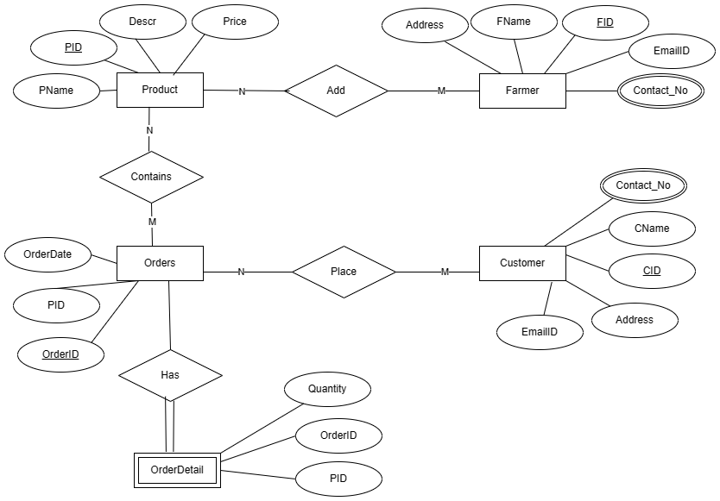
ER Diagram

Slide 4
FARMER
create table Farmer(
FID int auto_increment primary key not null,
FName varchar(255),
EmailID varchar(100),
Address varchar(255),
Contact_No char(10),
constraint f_Email check (EmailID regexp ‘^[a-zA-Z0-9._%+-]+@[a-zA-Z0-9.-]+\.[a-zA-Z]{2,}$'),
constraint f_Contact_No check (length(Contact_No)=10)
);
CUSTOMER
create table Customer(
CID int auto_increment primary key not null,
CName varchar(255),
EmailID varchar(100),
Address varchar(255),
Contact_No char(10),
constraint c_Email check (EmailID regexp '^[a-zA-Z0-9._%+-]+@[a-zA-Z0-9.-]+\.[a-zA-Z]{2,}$'),
constraint c_Contact_No check (length(Contact_No)=10)
);

Slide 5
PRODUCT
create table Product(
PID int auto_increment primary key not null,
PName varchar(255),
Descr varchar(255),
Price decimal(10,2) default 0.00,
Quantity int default 0,
FID int,
foreign key (FID) references Farmer(FID) on update cascade on delete cascade
);
ORDER
create table Orders(
OrderID int auto_increment primary key not null,
OrderDate timestamp default current_timestamp,
CID int,
foreign key (CID) references Customer(CID) on update cascade on delete cascade
);

Slide 6
ORDER DETAIL
create table OrderDetail(
OrderID int,
PID int,
Quantity int,
foreign key(OrderID) references Orders(OrderID),
foreign key(PID) references Product(PID),
);

Slide 7
FARMERS
insert into Farmer (FName, EmailID, Address, Contact_No)
values
('Kaushal Khatiwada', 'kk@abc.com', 'Kaushaltar', '1111111111'),
('Gopal Khadka', 'gkh@abc.com', 'Gaushala', '2222222222'),
('Rajendra Nepal', 'rn@abc.com', 'Rampur', '3333333333');
CUSTOMERS
insert into Customer(CName,EMailID,Address,Contact_No)
values
('Gaurav Bhattarai', 'gb@abc.com', 'Kritipur', '4444444444'),
('Abin Shrestha', 'as@abc.com', 'Gaushala', '5555555555'),
('Prakash lama', 'pl@abc.com', 'Balkhu', '6666666666');
PRODUCTS
insert into Product(PID,PName,Descr,Price,Quantity,FID)
values
(1,"Cauliflower","Fresh Cauli flower",100,20,1),
(2,"Potato","Mustang Potato",200,30,1),
(3,"Tomato","Red Tomato",200,5,2),
(4,"Egg","Newly hatched Egg",20,100,2),
(5,"Apple","Mustang Apple",70,50,3),
(6,"Orange","Juicy Orange",30,40,3);

Slide 8
ORDER PLACED BY CUSTOMER
insert into Orders(OrderID,CID)
value(1,1),
(2,2),
(3,3);
ORDER ITEMS IN ORDER
insert into OrderDetail(OrderID,PID,Quantity)
value(1,5,5),
(1,3,5),
(2,1,3),
(2,2,10),
(3,4,12),
(3,6,20);

Slide 9
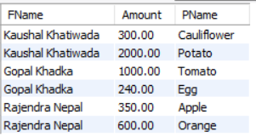
JOIN, AGGREGATE, GROUP BY
-- Get Farmers Sales By Product
create view FamerSaleByProduct as
select F.FName, sum(P.Price * Od.Quantity) as Amount,P.PName
from OrderDetail Od
inner join Product P
on P.PID= Od.PID
inner join Farmer F
on F.FID = P.FID
group by F.FName,P.PName;
select * from FamerSaleByProduct;

Slide 10

JOIN, AGGREGATE, GROUP BY
-- Get Farmers Total Sales
Create view VW_FarmerTotalSales as
select F.FName, sum(P.Price * Od.Quantity) as Total
from OrderDetail Od
inner join Product P
on P.PID= Od.PID
inner join Farmer F
on F.FID = P.FID
group by F.FName
order by Total;
select * from VW_FarmerTotalSales;

Slide 11

STORED PROCEDURE
-- Get Farmers Products from FarmerID
DELIMITER $$
CREATE PROCEDURE GetFarmerProducts(in farmer int)
BEGIN
SELECT PID,PName,Descr,Price
FROM Product
WHERE FID = farmer;
END$$
DELIMITER ;
call GetFarmerProducts(1);

Slide 12

STORED PROCEDURE
-- Get Customer Purchased Products from CustomerID
DELIMITER $$
CREATE PROCEDURE GetCustomerProducts(in customer int)
BEGIN
select C.CName,P.PName,Od.Quantity,O.OrderDate,P.Price,Od.Quantity*P.Price as Amount
from OrderDetail Od
inner join Orders O
on Od.OrderID=O.OrderID
inner join Customer C
on O.CID=C.CID
inner join Product P
on P.PID= Od.PID
where O.CID = customer;
END$$
DELIMITER ;
show procedure status;
call GetCustomerProducts(1);

Slide 13
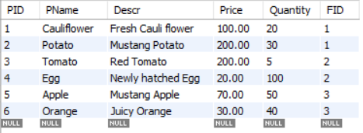
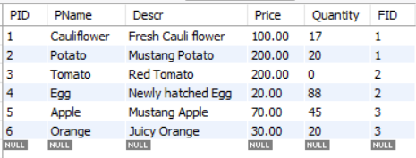
TRIGGERS
-- To reduce stock quantity after Order Placement by customer
CREATE TRIGGER update_product_quantity
AFTER INSERT ON OrderDetail FOR EACH ROW
UPDATE Product
SET Quantity = Quantity - NEW.Quantity
WHERE PID = NEW.PID;

Slide 14
THANK YOU

